Slide 1
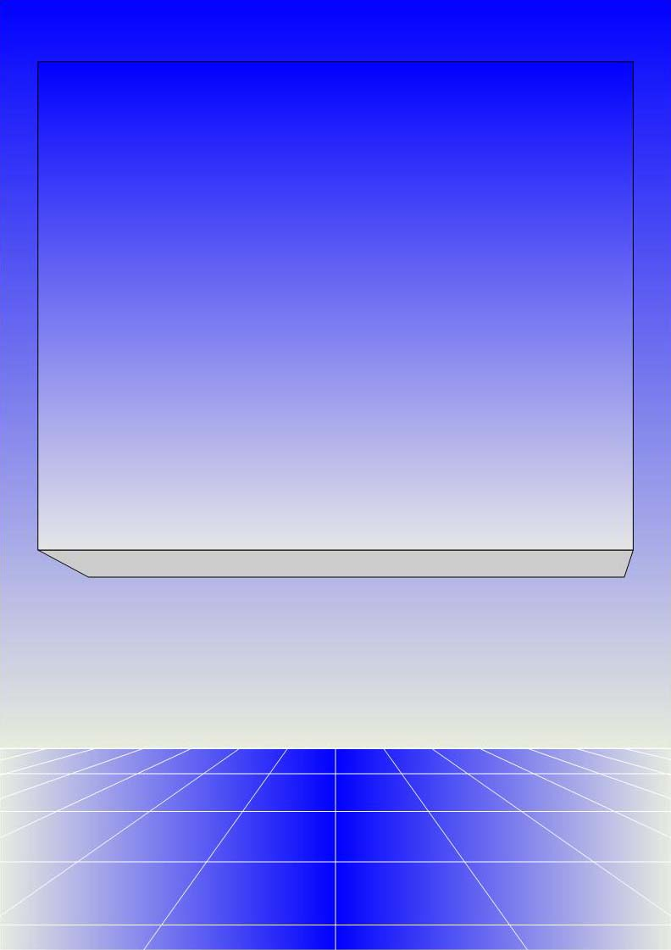
CO2402 - Advanced Programming with C++
Week 23 –
Templates + casting + Self-documenting code
Gareth Bellaby

Slide 2

Topics
Templates
Casting
Self-documenting code

Slide 3
Topic 1
Templates

Slide 4
Templates
An extension to Object Oriented Programming.
Generic programming is a style of programming in which algorithms are written without specifying the data type.
Templates enable generic programming in C++.
C++ test question:
    "Show how you would declare a linked list that you could use to store multiple object types using either C++ or C#."

Slide 5
Templates
Allows you to declare generic functions and classes. Generic functions and classes can operate on a variety of different types or classes.
These are operations that are not tied to a particular data type.
The STL is created out of templates.
For example, consider a swap function. We want to be able to swap two items- this is the same whether they're integers, characters, strings, etc.

Slide 6
Templates
Some functions can be applied generically to a multitude of objects.
It makes sense to define these only once.
This is done using templates.
The compiler implements the specific versions of the functions that are needed when calls to them are made, i.e. at compile time.

Slide 7
Defining a template
Use the keyword template. This announces that the function is a template rather than a normal function.
Need a placeholder for the data type used by the function. In the example the placeholder is labelled T.
template <class T> void trivial( T term )
The placeholder name is preceded by the keyword class and enclosed by chevrons.
Although class is used, it can be considered a data type (indeed the keyword typename can be used instead). The name may be used within the function definition. The compiler automatically substitutes the correct data type when it creates a specific version of the function.

Slide 8
Defining a template
The rest of the function is identical to a normal function. The only difference is that the placeholder name is used instead of the data type.
template <class T> void trivial( T term )
In this particular example the name of the variable is term. The data type is treated as being of type T.

Slide 9
Trivial template function
template <class T> void trivial( T term )
{
cout << term << endl;
}
int main()
{
int var = 5;
trivial( var );
trivial( 'a' );
trivial( "the rain in spain" );
trivial( 73.4f );
}

Slide 10
Templates
The general form of a template function definition is:
template <class Ttype> return-type name
( parameter-list )
{
// body of template
}
Templates are expanded at compile time.

Slide 11
Example: mySwap
// Exchange values stored at leftTerm and rightTerm.
// The version in std::swap is virtually identical except
// defined as an inline function:
// template <class T> inline void mySwap
// T& leftTerm, T& rightTerm )
template <class T> void mySwap
( T& leftTerm, T& rightTerm )
{
T temp;
temp = leftTerm;
leftTerm = rightTerm;
rightTerm = temp;
}

Slide 12
Example: mySwap
A template function which swaps the values of two objects.
The template is called mySwap.
It defines a template with T as a placeholder.
The template does not return a value do it is void.
The template receives two variables of type T in its argument list.
For speed all of the variables are defined as reference variables.

Slide 13
Example: using mySwap
int main()
{
int a = 5;
int b = 10;
mySwap( a, b ); // swap values of a and b
cout << a << " " << b << endl;
// output 10 5
}
Used in the same way as any standard function.

Slide 14
Function Templates
The function template is automatically expanded into a 'standard' function when it is used.
Classes or built in types can be specified.
For later: If the function is provided inline, then the compiler is likely to optimise the overloaded operator > into a normal > test for built in types.
For later: It is possible to overload function templates with other function templates or non-templated functions.

Slide 15
Example: myMin
template <class T> const T& myMin
( const T& leftTerm, const T& rightTerm )
{
if( leftTerm < rightTerm )
{
return leftTerm;
}
return rightTerm;
}

Slide 16
Example: using myMin
int main()
{
int a = 5;
int b = 10;
int c = myMin( a, b );
cout << c << endl; // output 5
}

Slide 17
Example: myMin
A template function which returns the minimum of two objects.
The template is called myMin.
It defines a template with T as a placeholder.
The template also returns the data type T.
The template receives two variables of type T in its argument list.
For speed all of the variables are defined as reference parameters, but they don't change so I've made them constants.

Slide 18
Multiple generic data types
// Toy example but hopefully clear
template <class T, class S> S multiply
(T item1, S item2)
{
return (item1 * item2);
}
int main()
{
cout << multiply( 2.6, 3 ); // output 7.8
}
A template can have more than one generic type. This example declares two different types.

Slide 19
Multiple generic data types
Using a comma separated list.
Each parameter in the list consists of a class/identifier pair.
When the function is invoked (called) then each of the placeholders is replaced by the parameter according to position.

Slide 20
Mixing data types
You can freely mix the generic data type and built in data types.
template <class T> T multiplyByInt
( T term, int n )
{
return term * n;
}
cout << multiplyByInt( 4, 3 );
cout << multiplyByInt( 2.4f, 3 )

Slide 21
Further generalisation
Templates will only work with data types for which the code makes sense. For example, mySwap would not automatically work with a c-type string and only some user defined classes:
temp = leftTerm;
This is because it uses an assignment statement.
The function would only work with a data type for which the assignment statement is defined.
For later: we could use "operator overloading" to define a new assignment statement which would work with other data types in order to extend the swap function.

Slide 22
When to use
A good place to use templates are helper functions, e.g. min, max or swap.
All of these are actually already defined in std precisely because they are so useful.
Useful for any sort of utility function.
Templates have been used to create the Standard Template Library.

Slide 23
When to use
Templates are type safe because they are expanded at compile time.
If a template is defined as inline then it incurs no extra run-time overhead.
A template has the same overhead as a standard function if it not declared inline.
Templates have superseded C-style macros, e.g. #define.
Some problems with debugging. Proposed revisions to the C++ standard to improve this.

Slide 24
How to use
Do not start with a template version.
Write the function using a data type.
Test it.
Rewrite the function, add the template keyword and substitute the placeholder for the data type.

Slide 25
Topic 2
Casting

Slide 26
Casting
Casting is the conversion of one data type to another. It is argued by some (e.g. Stroustrup) that casts should be avoided. Casting truncates values. It is not the equivalent of rounding!

Slide 27
C style Casting
Casting is the conversion of one data type to another. It is argued by some (e.g. Stroustrup) that casts should be avoided. Casting truncates values. It is not the equivalent of rounding!
The style is changing.

Slide 28
Traditional Casting
In traditional C or C++ you supply the data type to be converted to. The data type is placed inside round brackets.
var1 = (data_type) var2;
For example:
float f = 34.8;
int i = (float) f; // i has a value of 34
Note truncation, not rounding.

Slide 29
New style Casting
The new style casts allow the programmer to state their intentions more clearly.
New style casts are more easy to spot in a program. More explicit as to the data type and the variable being changed.
There are now four types of casting:
    static_cast
    reinterpret_cast
    dynamic_cast
    const_cast

Slide 30
static_cast
The most common form of casting.
For normal conversion between data types.
No runtime checks performed.
var1 = static_cast <data_type>(var2);
For example:
float f = 34.8;
int i = static_cast <float>(f);

Slide 31
reinterpret_cast
Casting between incompatible pointer types, e.g. casting between unrelated pointers.
For instance, a char pointer pointing at an integer.
Not a particularly common operation but can be useful. Packing bytes into a word, e.g. chars into an integer. I might want to perform the operations of packing or examining the individual bytes using a pointer.

Slide 32
reinterpret_cast
The following code won't work:
int i = 4;
char* ptr;
ptr = &i;
The compiler error message is: "cannot convert from 'int *' to 'char *'. Types pointed to are unrelated; conversion requires reinterpret_cast, C-style cast or function-style cast"

Slide 33
reinterpret_cast
Instead use reinterpret_cast
int i = 4;
char* ptr;
ptr = reinterpret_cast<char*>(&i);

Slide 34
dynamic_cast and const_cast
dynamic_cast
  Can only be used with pointers and references. Use to ensure that the cast is valid. Performs a run-time check. Returns 0 if the cast is not valid. For example, instances of base and derived classes and pointers of the respective types.
  Moving the pointer up or down the class hierarchy.
const_cast
  Casting away const or volatile.

Slide 35
Topic 3
Self-documenting code

Slide 36
Comments
I am interested in looking at this topic in the light of the assignment you have just completed.
Was the style guide useful?
What do think about style guides in general?
What role do you think comments play in writing code?

Slide 37
Comments
The style guide attempted to promote code which explained itself.
The naming conventions promoted consistency and clarity.
The guide suggests ways to make the code more readable, more natural language like.

Slide 38
Self-documenting code
Self-documenting code is the idea or approach that you can produce code which is self-explanatory.
An objective is to minimise the amount of external documentation. Perhaps even to dispense with external documentation entirely.
Aim make code easy to understand. The code should explain itself.
Clear and understandable names. The names should explain themselves.
Code should read like natural language.

Slide 39
Self-documenting code
A clear and clean structure. For instance, you will have noticed that I've said that I like certain forms of code because I think they are easier to understand.
Consistency of approach. If a consistent approach is taken then it is easier to understand any particular code piece.
Consistent naming conventions.
Use of strong scope conventions. If strong scope rules are enforced then names are more meaningful, you don't get name clashes (and hence ambiguity).

Slide 40
Automatic documentation generators
Visual Studio and other applications have some elements of automatic documentation generation. Intellisense will read the signature of methods and state the data type of the methods parameters.
Context-sensitive help. For instance, can have Intellisense include function or method description in the pop-up box.
Further to this are applications which generate indexes, diagrams, etc. from the code.

Slide 41
Comments and code
Self-documenting code can be taken to mean that comments are entirely dispensed with.
The argument is that good, clear and clean code does not need any further explanation.

Slide 42
Comments and code
One does not need to be doctrinaire about this.
I personally do not feel that one should eschew all documentation.
A good principle is you should not need comments to explain the details of your code. If a line is so obscure that it needs a comment to explain its function then this suggests that the code is unclear and poorly written.
The style guide suggested that comments should be written at the level of the code's intent.

